Slide 1
Web Design Basics

Slide 2
WHAT IS A WEBSITE?
A group of web pages ( Home/About Us/ Contact)
Assigned with a domain name ( www.mywebsite.com)
Hosted on an internet server (Bluehost , Godaddy ,Bigrock)
Interlinked with each other through navigation (Menu / Hyperlinks)

Slide 3
WHAT IS A WEB PAGE?
A document written in HTML (.html)
Interpreted by web Browsers (Google chrome)
The look and feel of the web page have to be uniform across all pages by
using style written in CSS
Any actions on the page ,like mouse click on a button will be written in a file called
javascript (.js)
A web Page contains (images , Links , Videos , Tables, Headlines , Paragraphs ,etc..)

Slide 4
HTML
CSS
Javascript

Slide 5
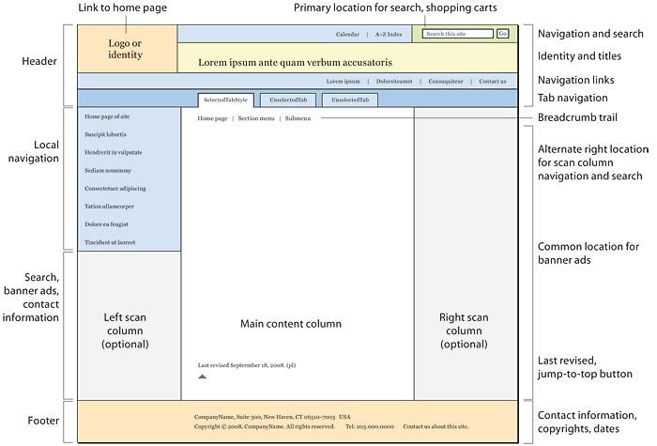
PARTS OF WEBSITE
Header
Body
SideBar
Footer

Slide 6
First Website goes live (1991)

Primary Function was to provide information

Images and media were not supported

Lightweight , optimized for slow internet connections

Interactivity was limited to links that brought you to other pages

Slide 7
TYPES OF WEBSITE
Static Website :
A static website is made up of webpages created using HTML, CSS and Javascript
The content won’t be changed unless the original html code is edited
Dynamic Website :
With a dynamic website all of your data and content are organized in a database or backend content management system

Slide 8
MAIN OBJECTIVES
Let People Find You
Increase Sales
Customer Support
Authoritative Resource
Information Delivery
Minimize cost

Slide 9
WEBSITE SERVICES
Responsive Design suitable for all device screens
Support more than one language
Search engines
Chat Box and Reviews
Embed google map and other contacting informations
Smooth design and easy loading
Easy Browsing
Payment through your website

Slide 10
CREATING WEBSITE
7 steps to success
01
02
03
04
05
06
07







Discovery
Planning
Design
content
development
Testing
Deployment
Website Purpose
Website Goals
Trarget Audiance
Sitemap
Website structure
Technology Used
Wireframe model
Visual style
Usability UI , UX
Copy Writing
Photos & Videos
SEO
Html & css
Database
Responsive
Technical Testing
Browser capability
Purpose testing
moniter
Bug fixes
maintenance

Slide 11
BREAK TIME !

Slide 12
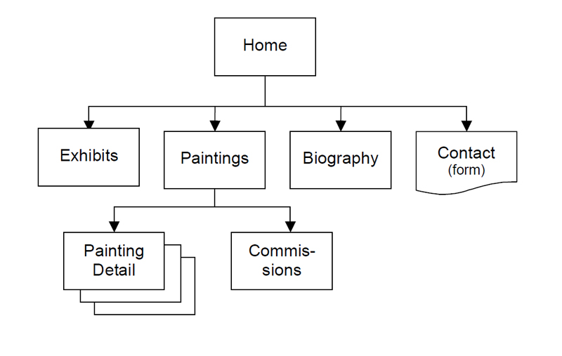
WHAT IS SITEMAP?
a resource that the client and the web design team can refer back to throughout the project. It's a handy tool that displays the relationships between your site's pages and its content elements. Ultimately, building a website without a sitemap is like building a house without blueprint
(.xml)

Slide 13
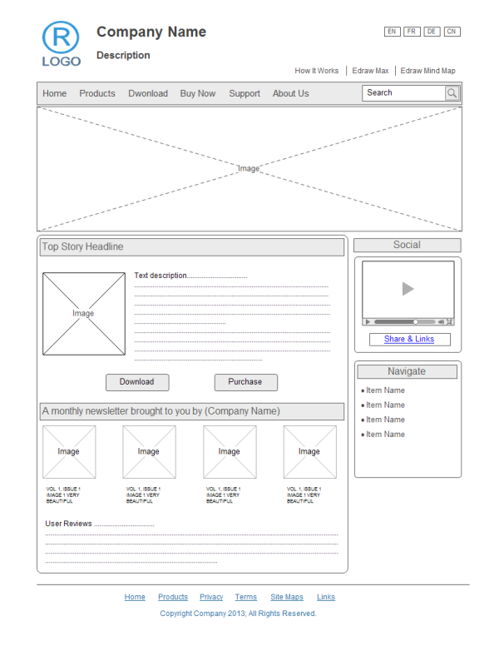
WIREFRAME MODEL?
a two-dimensional illustration of a page's interface that specifically focuses on space allocation and prioritization of content, functionalities available, and intended behaviors.

Slide 14
UNDERSTANDING COLORS
Hue : simply the color’s name (yellow,green) with no light or dark added
Value : value refers to the lightness or darkness of a color
Saturation : strength of the color , adding Grey and White decreases saturation

Slide 15
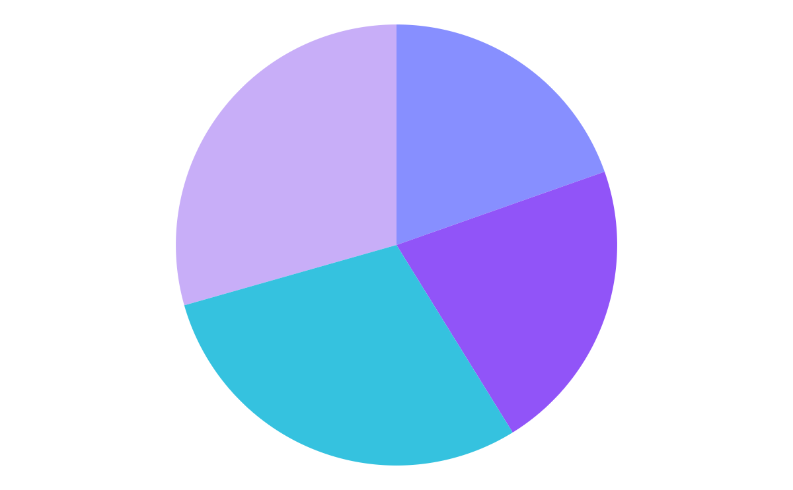
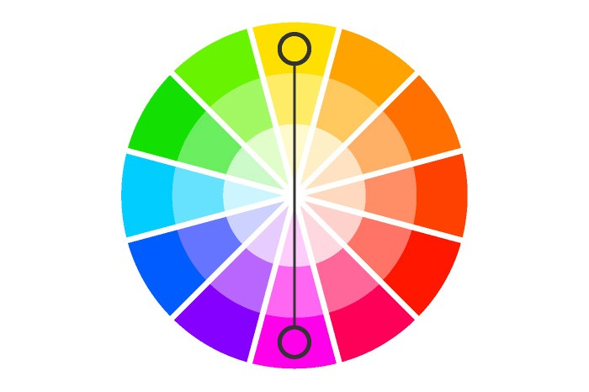
Monochromatic Scheme
CHOOSING COLORS
Many Theories to use
Analogus color Scheme
Triadic color scheme
complementary color Scheme

Slide 16
USEFUL SITES
Color.adobe
https://color.adobe.com/
Mycolor.space
https://mycolor.space.com/

Slide 17
How TO MAKE OUR WEBSITE RESPONSIVE ?
Meta viewport
4. Max-width
2. Grid View
5. Bootstrap
3. Media Query

Slide 18
THANK YOU
FOR WATCHING

