Slide 1
Cyber Security Awareness
Author’s name: Samer Saad
Security Level:

Slide 2
Need for Cyber Security
Threats:
Hacking
Malware
Phishing
Personal Privacy
Public Wi-Fi
Passwords
Router
Internet of Things (IOT)

Slide 3
Why is Cyber Awareness Important?
Cyber crime is a growing trend
Raise awareness of threats
As with most crimes the police can’t tackle this problem alone
To encourage reporting
Promote Government backed scheme ‘Cyber Essentials’
Cyber crime is massively under reported.

Slide 4
Who is doing the hacking?
Financial (theft, fraud, blackmail)
Political /state (state level/ military)
Fame/ kudos (fun/ status)
Hacktivism (cause)
Pen testers (legal hacking)
Police
Insider
Business

Slide 5
Common threats - Ransomware
Normally loaded onto a computer via a download/attachment/link from an email or website.
Will either lock the screen or encrypt your data.
Once Ransomware is uploaded on your computer/tablet/phone it is very difficult to remove without removing all of the data
Wannacry attack 2017 - One of the biggest cyber attacks to occur.
Is said to have hit 300,000 computers in 150 countries.
Companies affected include; NHS, Renault, FedEx, Spanish telecoms and gas companies, German railways.

Slide 6
How to tackle Ransomware
Back up- Keep a backed up copy of your data. Ensure its not permanently connected to the network.
Patch- Keep your software up to date. Wannacry was successful as those affected computers hadn’t updated. The update contained a fix for the problem.
Attachments- Don’t click on links from emails/SMS as this could easily be from an untrusted source and contain malware like Ransomware

Slide 7
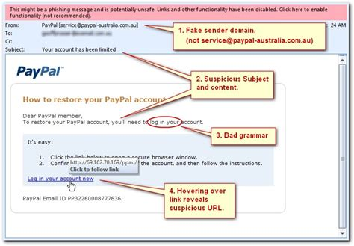
Phishing
Is the attempt to obtain sensitive information by deception.
They will be after your login credentials, payment card details or to upload malware to your computer
The email will normally impersonate a genuine company or person.
How to tackle the problem ?
Don’t click any links on an email unless you can guarantee who its from.
Use a trusted method of contacting the company via a phone number, app or website.
Mark the email as spam and contact the organisation.

Slide 8
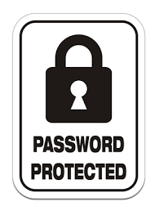
Passwords Advice
Use 1 password per account.
Three random words is the NCSC’s advice. Capitals, special characters and numbers is your own choice.
If you follow this advice your passwords security will be significantly increased against a brute force attack.
Password managers can be helpful to store your passwords.

Slide 9
Advice
Update and migrate
Activate your firewall
Staff awareness
Data encryption
User accounts privileges i.e admin
Cyber insurance
Prepare Plan

Slide 10
You are the best defence!
Technology is only a small part of Cyber Defence
You are the most important person – protect yourself
For businesses the most important and best defence is Cyber Security Aware employees – train your staff
Always be aware!
Always be on your guard!

